Slide 1
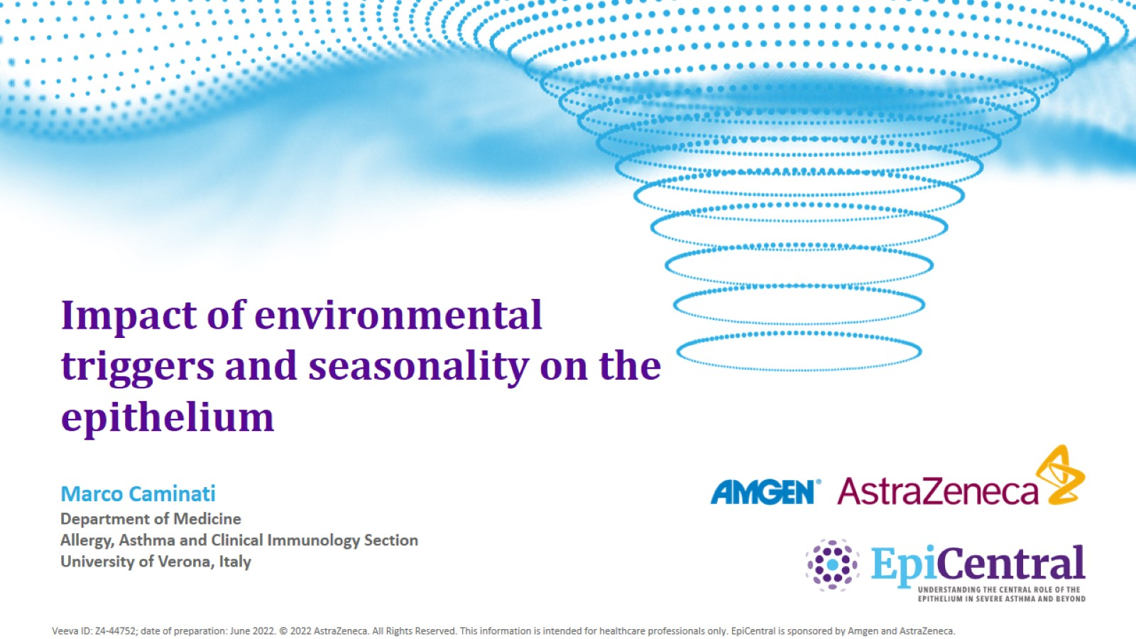
Impact of environmental triggers and seasonality on the epithelium

Slide 2

Conflicts of interest disclosure

Slide 3
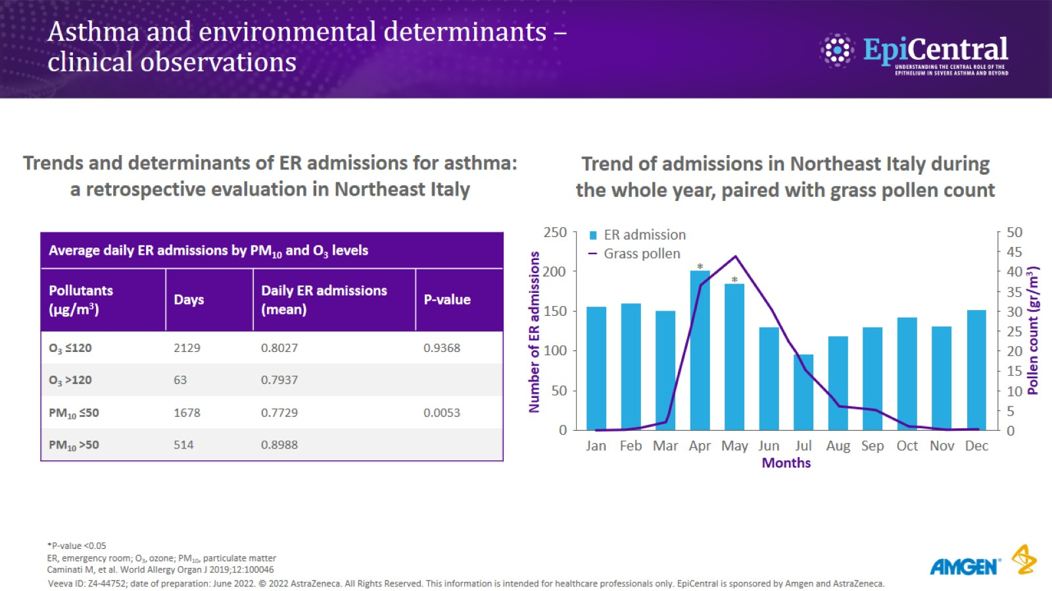
Asthma and environmental determinants – clinical observations

Slide 4
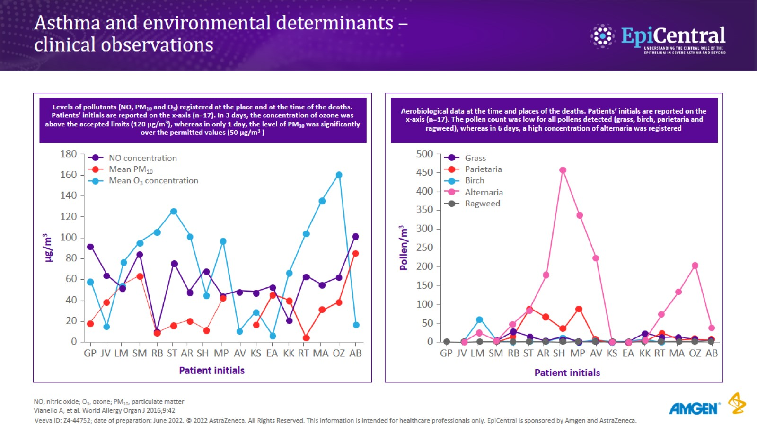
Asthma and environmental determinants – clinical observations

Slide 5
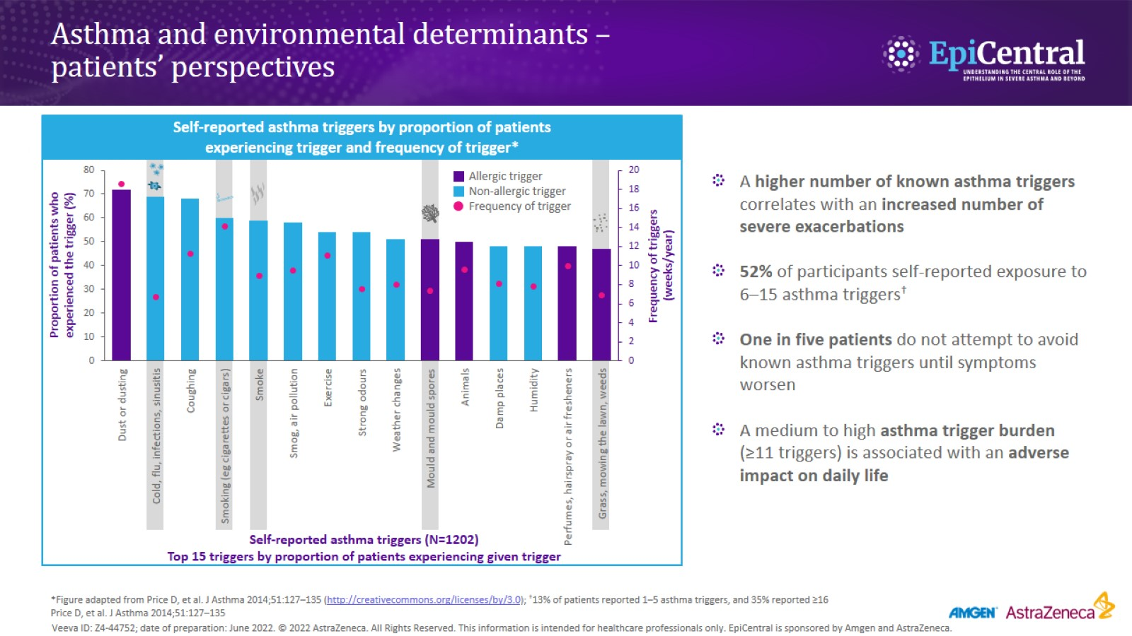
Asthma and environmental determinants – patients’ perspectives

Slide 6
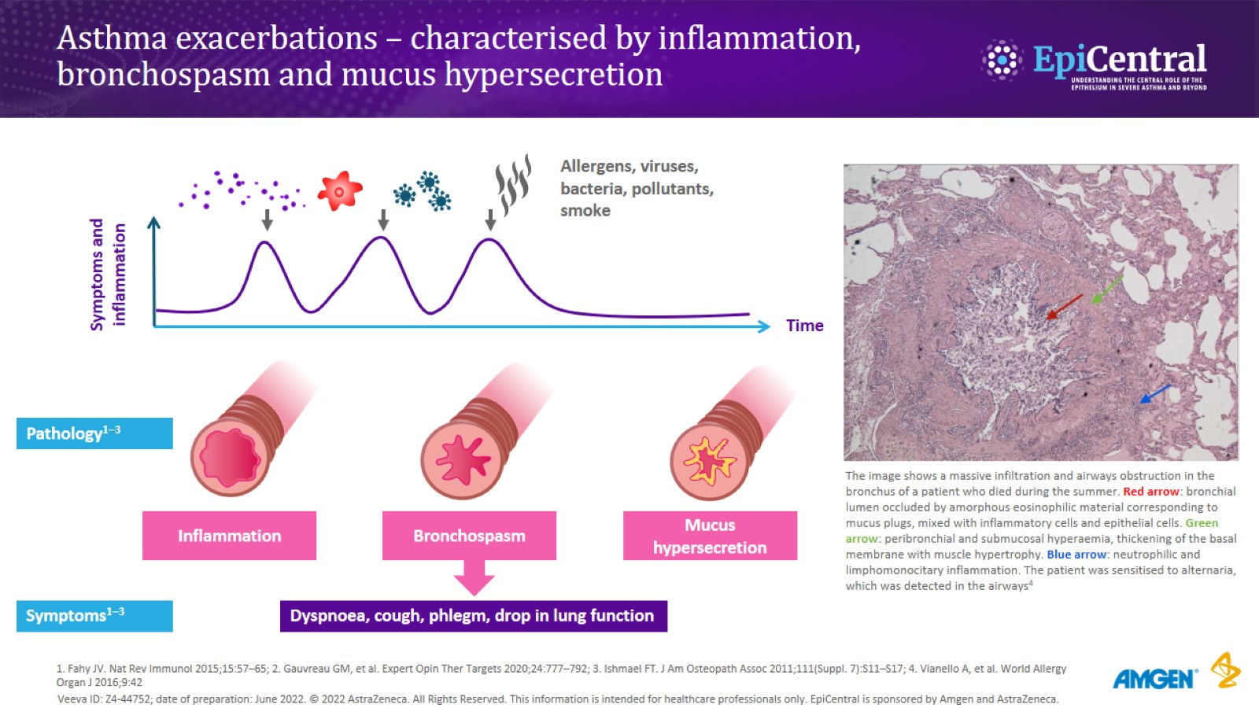
Asthma exacerbations – characterised by inflammation, bronchospasm and mucus hypersecretion

Slide 7
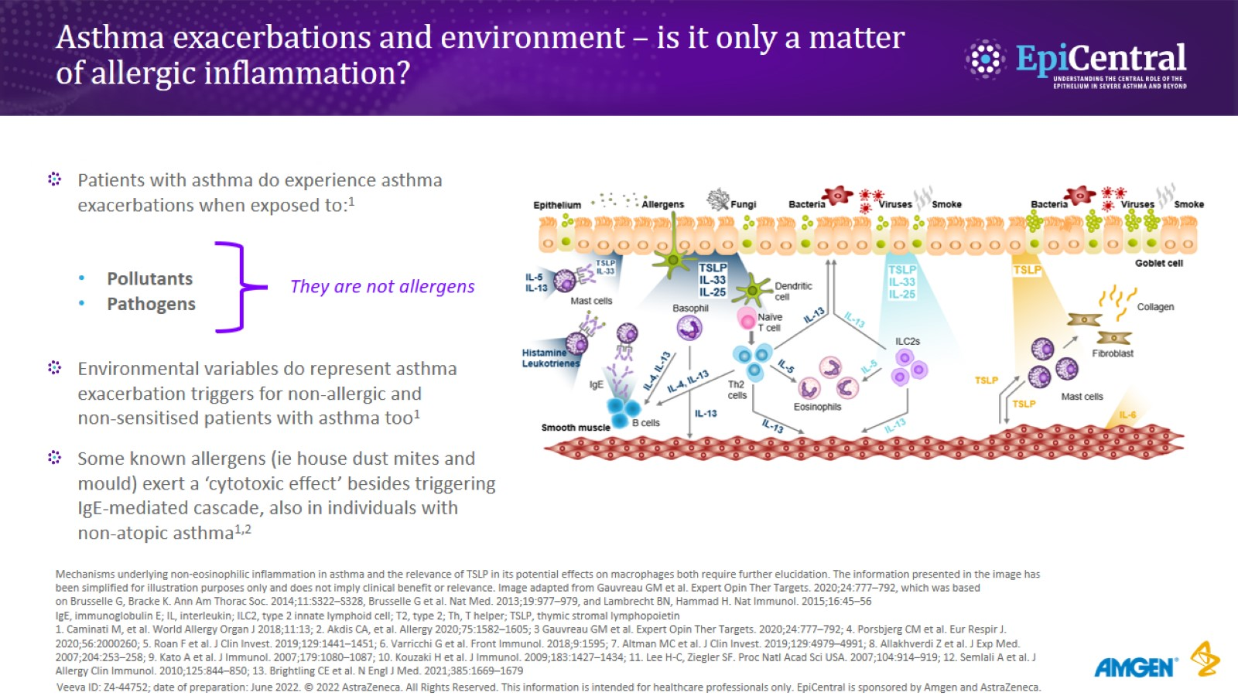
Asthma exacerbations and environment – is it only a matter of allergic inflammation?

Slide 8
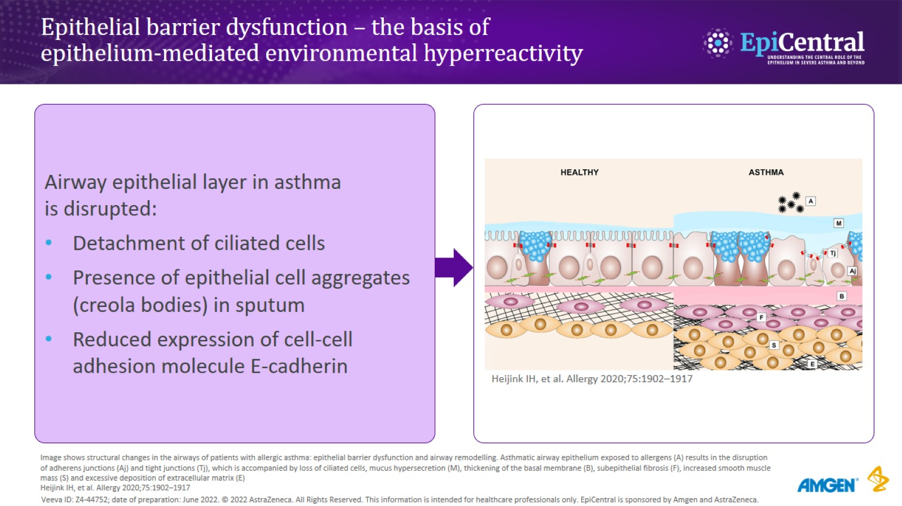
Epithelial barrier dysfunction – the basis of epithelium-mediated environmental hyperreactivity

Slide 9
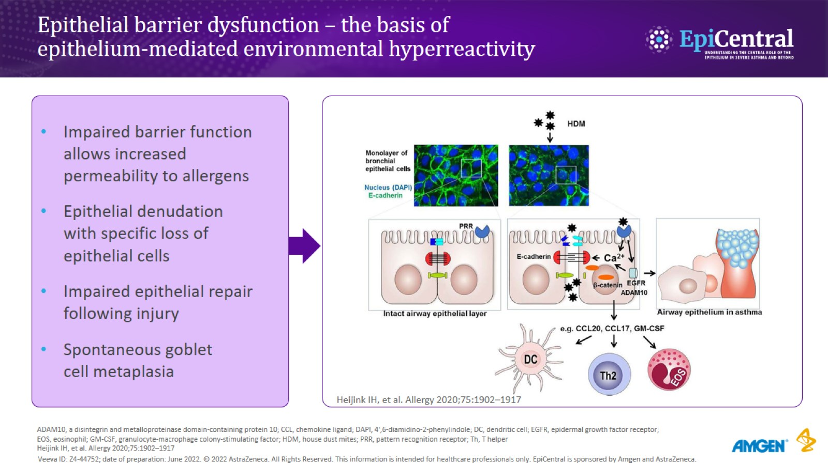
Epithelial barrier dysfunction – the basis of epithelium-mediated environmental hyperreactivity

Slide 10
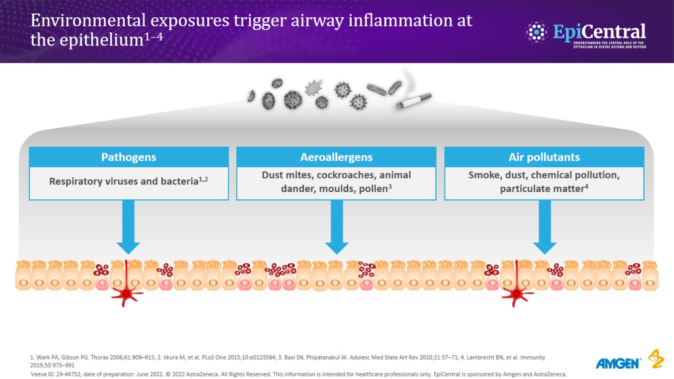
Environmental exposures trigger airway inflammation at the epithelium^{1–4}

Slide 11
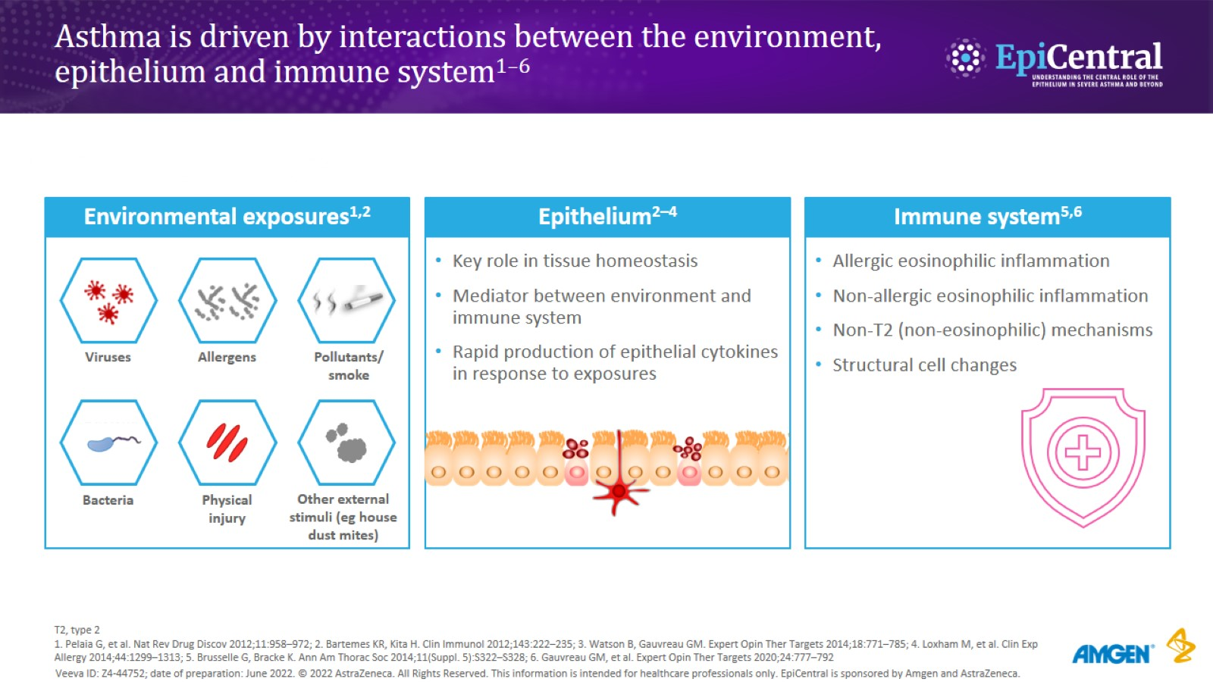
Asthma is driven by interactions between the environment, epithelium and immune system^{1–6}

Slide 12
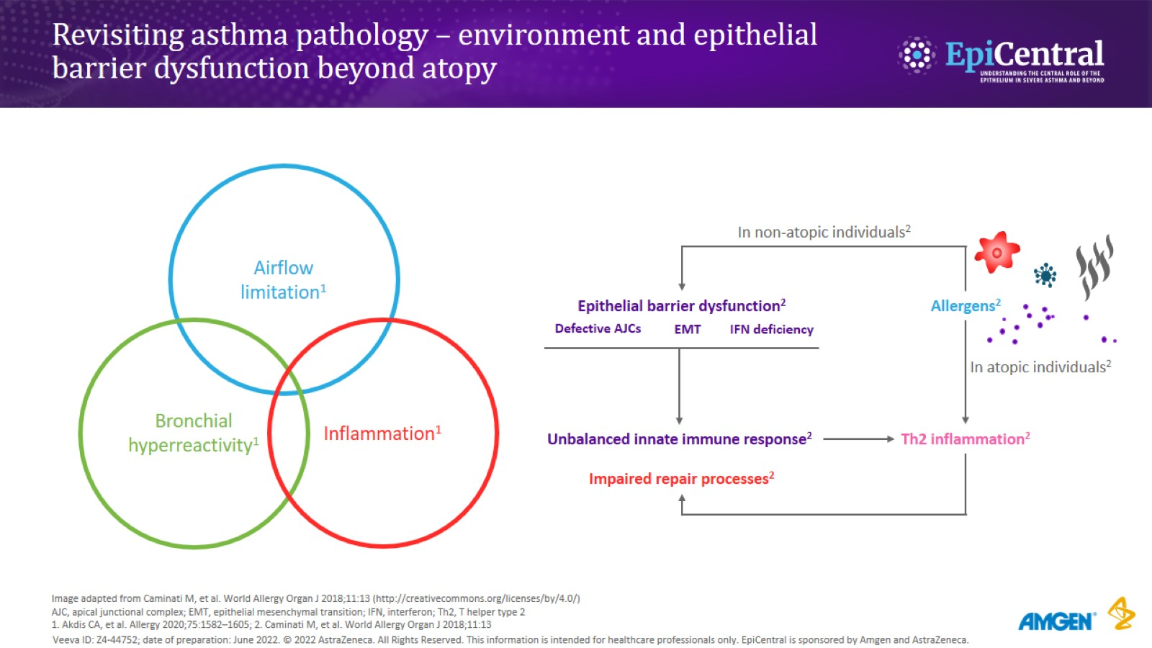
Revisiting asthma pathology – environment and epithelial barrier dysfunction beyond atopy

Slide 13
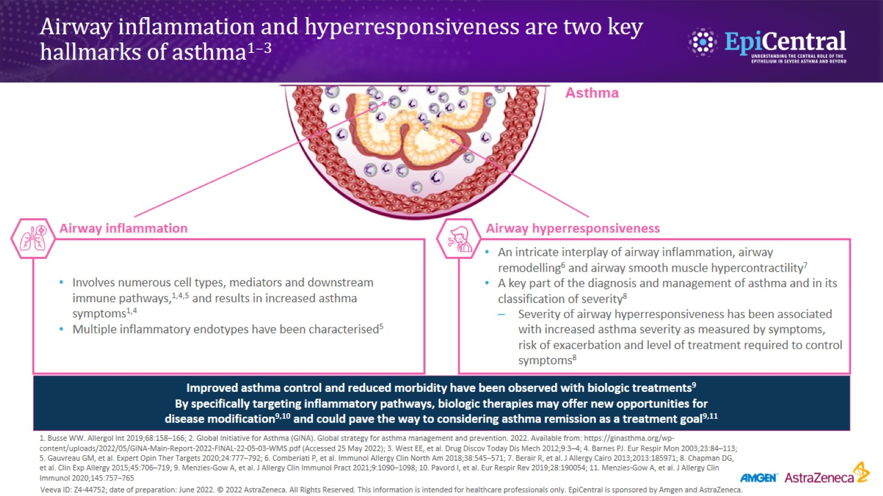
Airway inflammation and hyperresponsiveness are two key hallmarks of asthma^{1–3}

Slide 14
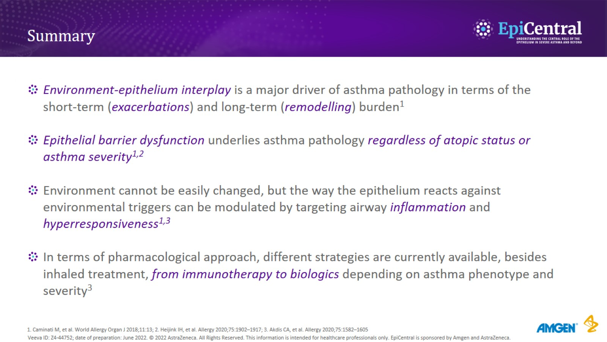
Summary

Slide 15

Many thanks for your attention

